Slide 1
EN811100 Linear Circuit Analysis
Chapter 1
Basic Concepts
Dec 20, 2019
C. K. Alexander – M. N. O. Sadiku Fundamentals of Electric Circuits, 5th Edition, The McGraw-Hill Companies 2013
J. A. Svoboda – R. C. Dorf
Introduction to Electric Circuits, 9th edition, John Wiley & Sons, Inc. 2014

Slide 2
Basic Concepts - Chapter 1
1.1 Introduction.
1.2 Systems of Units.
1.3 Electric Charge.
1.4 Current.
1.5 Voltage.
1.6 Power and Energy.
1.7 Circuit Elements.

Slide 3
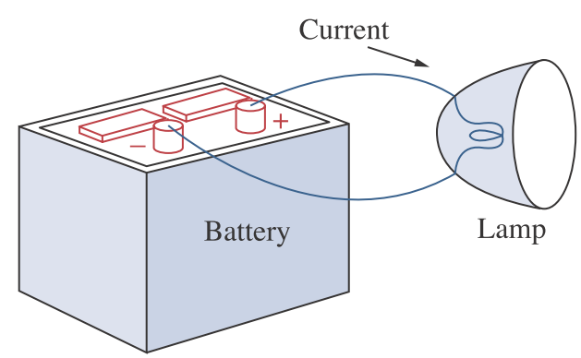
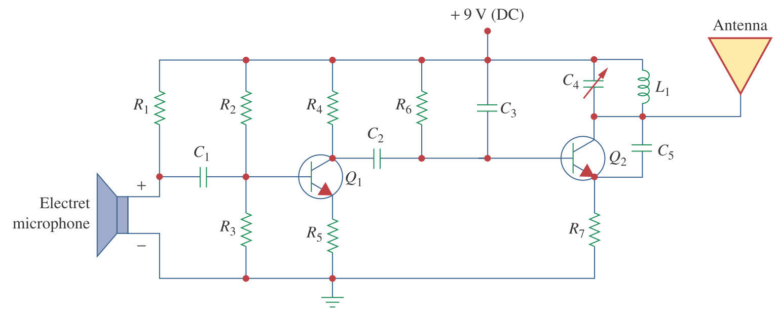

1.1 Introduction

Slide 4
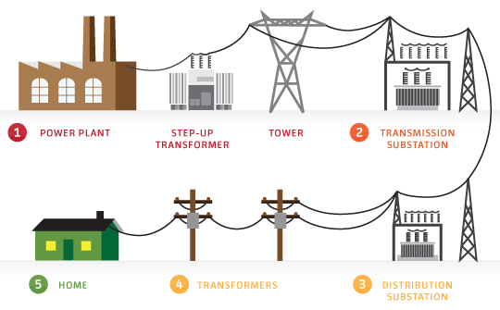

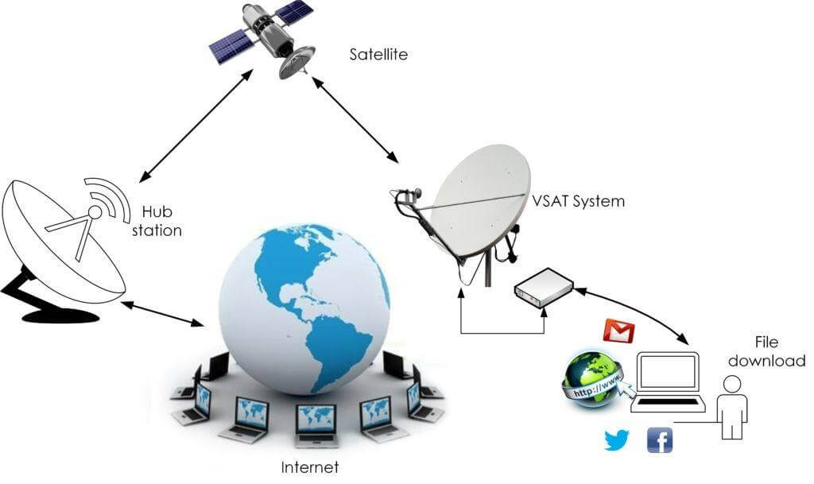
1.1 Introduction
Power System
Electronic System
Communication System

Slide 5
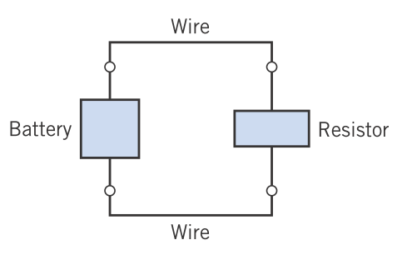
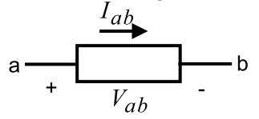
1.1 Introduction
2 circuit elements
A general two-terminal electrical element

Slide 6
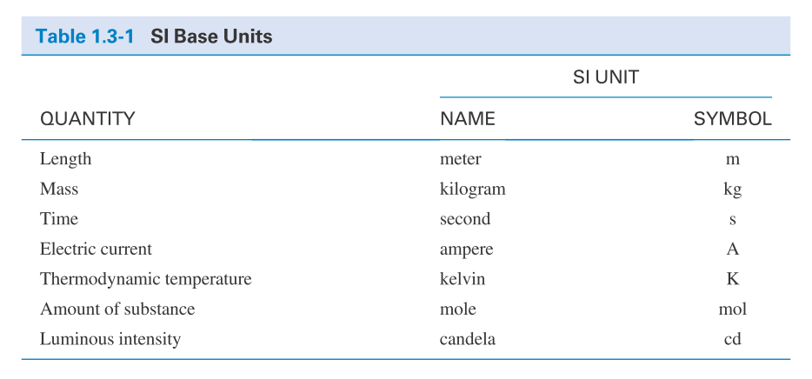
1.2 System of Units

Slide 7
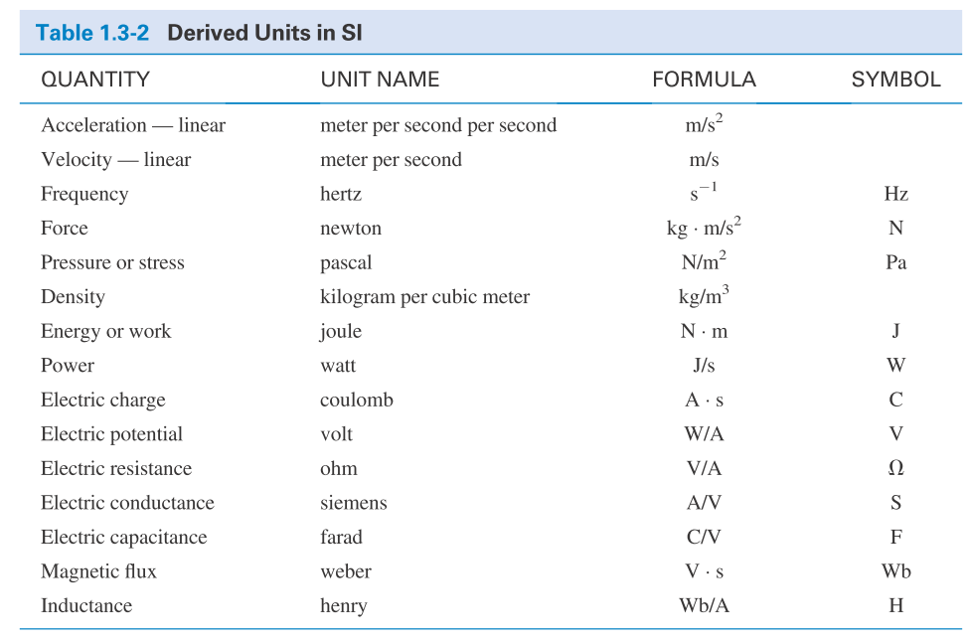
1.2 System of Units

Slide 8
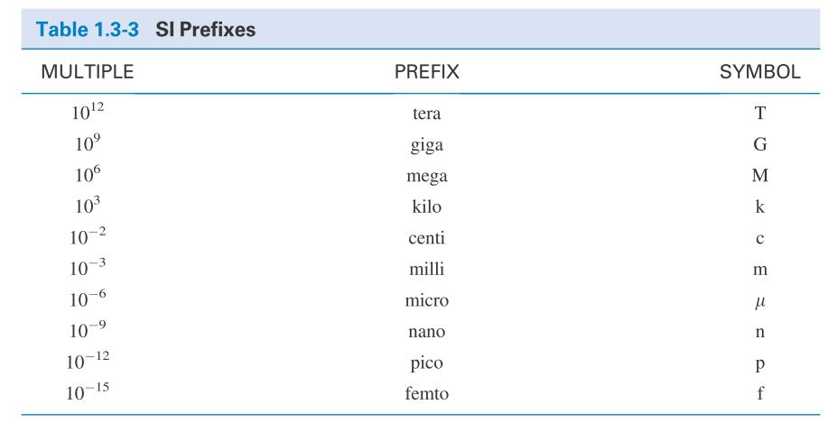
1.2 System of Units

Slide 9
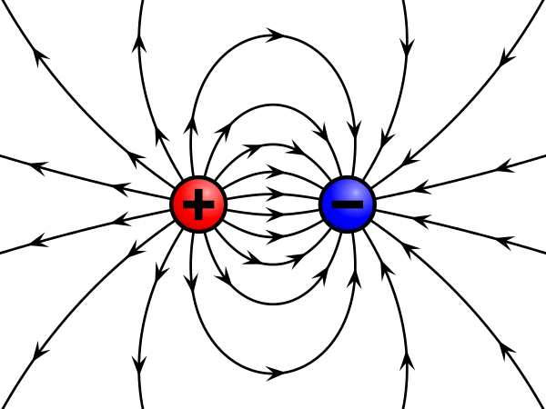
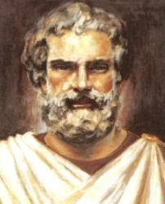
1.3 Electric Charges
Charge is an electrical property of the atomic particles of which matter consists, measured in coulombs (C).
The charge e on one electron is negative and equal in magnitude to 1.602 × 10⁻¹⁹ C which is called as electronic charge. The charges that occur in nature are integral multiples of the electronic charge.
Thales of Miletus
(640 – 546 B.C.)

Slide 10
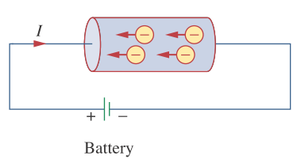
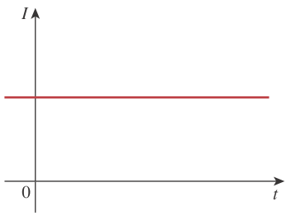
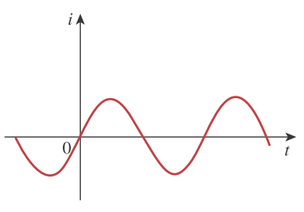
1.4 Current
ค่ากระแสไฟฟ้าคือปริมาณประจุที่เคลื่อนที่
ผ่านแท่งตัวนำในระยะเวลา 1 วินาที
Electric current
1.1
The unit of ampere can be derived as 1 A = 1C/s.
A direct current (dc) is a current that remains constant with time.
An alternating current (ac) is a current that varies sinusoidally with time. (reverse direction)
DC
AC

Slide 11
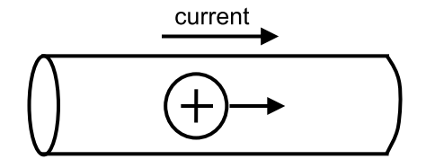
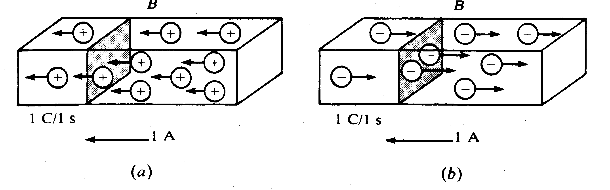
1.4 Current
The ﬂow of current is conventionally represented as a ﬂow of positive charges.
The direction of current flow
Positive ions
Negative ions

Slide 12
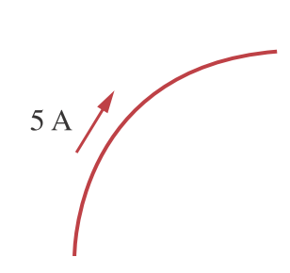
1.4 Current
Example 1
A conductor has a constant current of 5 A.
How many electrons pass a fixed point on the conductor in one minute?

Slide 13
1.4 Current
Solution
Total no. of charges pass in 1 min is given by
5 A = (5 C/s)(60 s/min) = 300 C/min
Total no. of electrons pass in 1 min is given

Slide 14

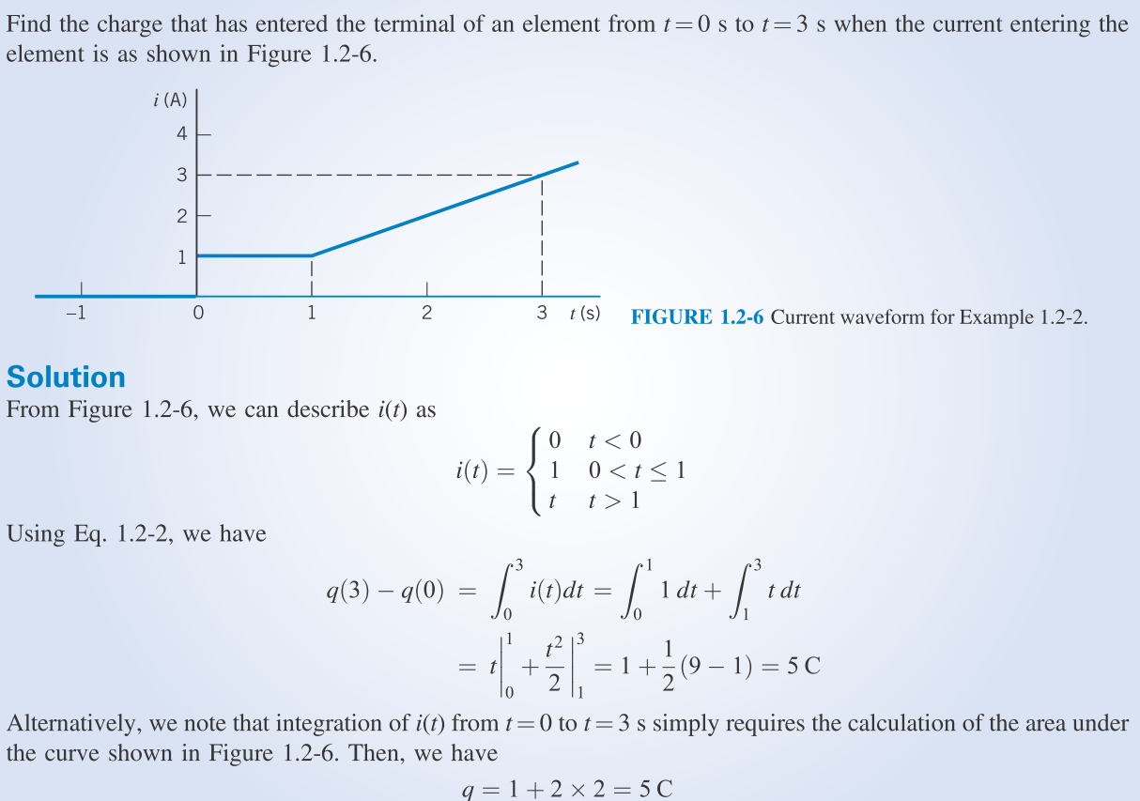

Example 2

Slide 15
1.5 Voltage
ค่าแรงดันไฟฟ้าคือพลังงานที่ต้องใช้ในการเคลื่อนที่ประจุ 1 หน่วย
ผ่านจากขั้วต้นทางไปยังขั้วปลายทาง
Voltage (or potential difference) is the energy required to move a unit charge through an element, measured in volts (V).
Mathematically,
1.2
w is energy in joules (J) and q is charge in coulomb (C).
Electric voltage, v_{ab,} is always across the circuit element or between two points in a circuit.
v_{ab} > 0 means the potential of a is higher than potential of b.
v_{ab} < 0 means the potential of a is lower than potential of b.
W=Work

Slide 16
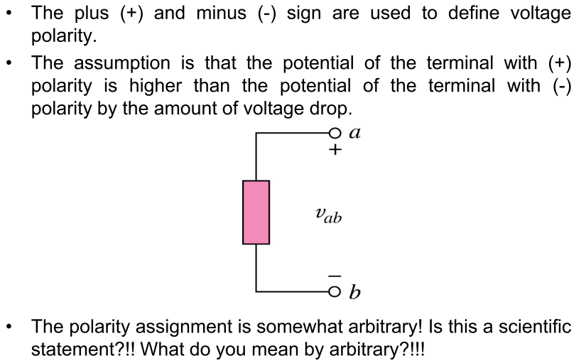
1.5 Voltage

Slide 17
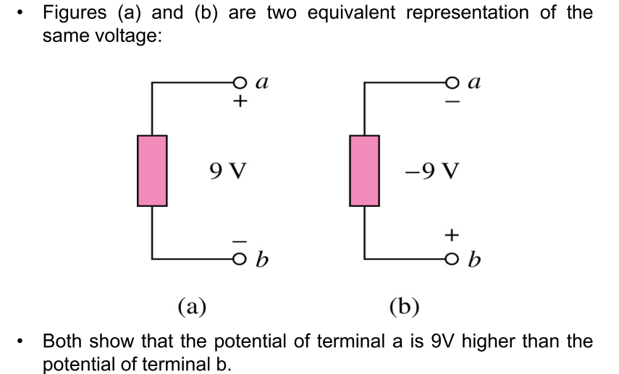
1.5 Voltage
V_{ab} = 9V
V_{ba} = -9V

Slide 18
1.6 Power and Energy
Power is the time rate of expending or absorbing energy, measured in watts (W).
Mathematical expression: 1.3
ปกติเรากำหนดให้กระแสไหล
จากแรงดันบวกไปแรงดันลบ
ถ้ากระแสไหลจากแรงดันลบ
ไปแรงดันบวก แสดงว่า
กระแสมีค่าติดลบ
i
i
+
+
ตัวรับ
Power
ตัวจ่าย
Power
v
v
–
–
Passive sign convention
P = +vi p = –vi
absorbing power supplying power

Slide 19
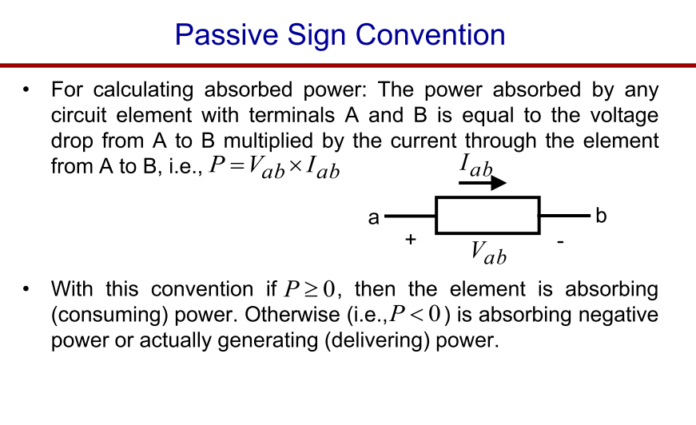
1.6 Power and Energy

Slide 20
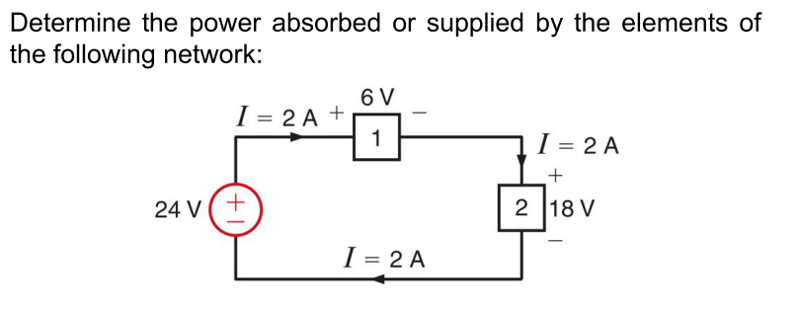

1.6 Power and Energy
Exercise
ตัวจ่าย Power
ตัวรับ
Power
ตัวรับ Power

Slide 21
1.6 Power and Energy
The law of conservation of energy must be obeyed in any electric circuit. For this reason, the algebraic sum of power in a circuit, at any instant of time, must be zero
Energy is the capacity to do work, measured in joules (J).
Mathematical expression 1.4

Slide 22
Side note
The Three Laws of Thermodynamics
The first law, also known as Law of Conservation of Energy, states that energy cannot be created or destroyed in an isolated system.
The second law of thermodynamics states that the entropy of any isolated system always increases.
The third law of thermodynamics states that the entropy of a system approaches a constant value as the temperature approaches absolute zero.
src: https://courses.lumenlearning.com/introchem/chapter/the-three-laws-of-thermodynamics

Slide 23
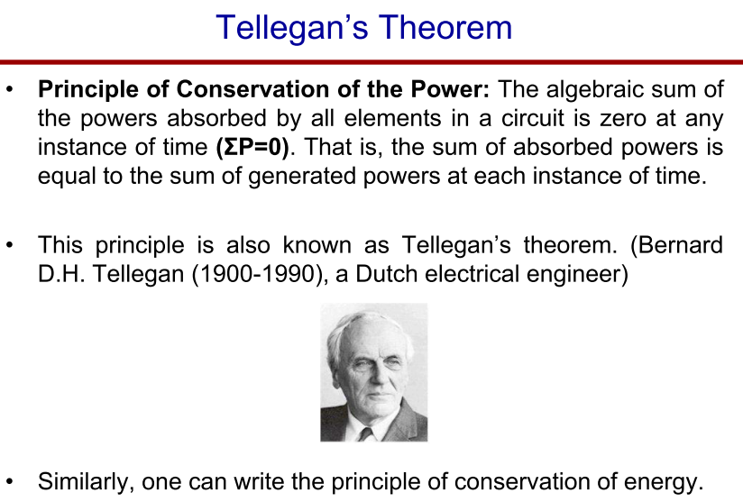
1.6 Power and Energy

Slide 24
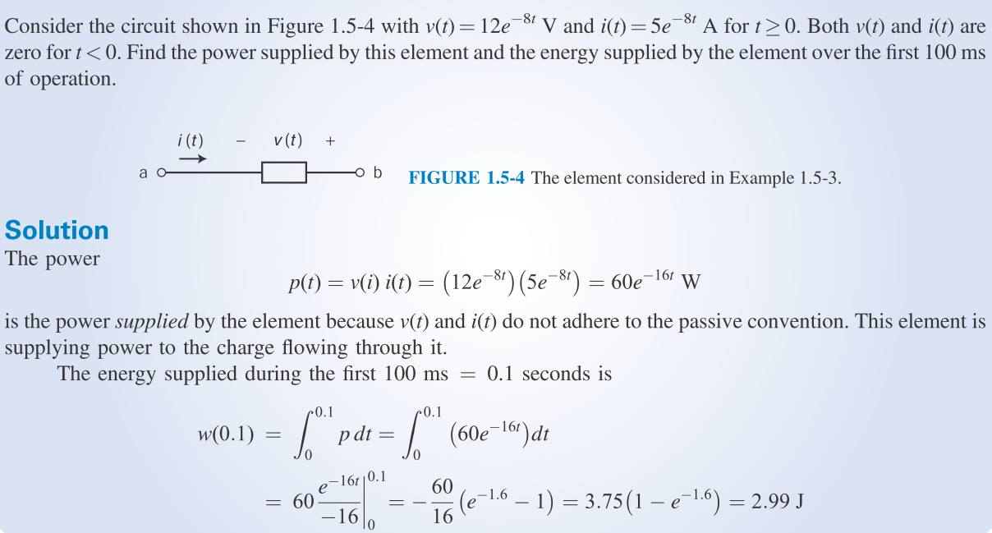
Example 3

Slide 25
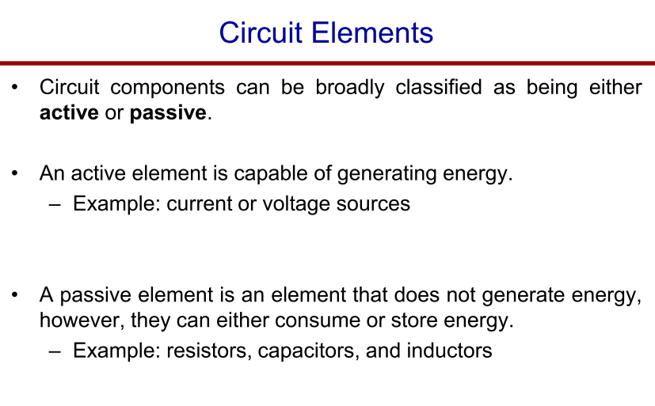
1.7 Circuit Elements

Slide 26
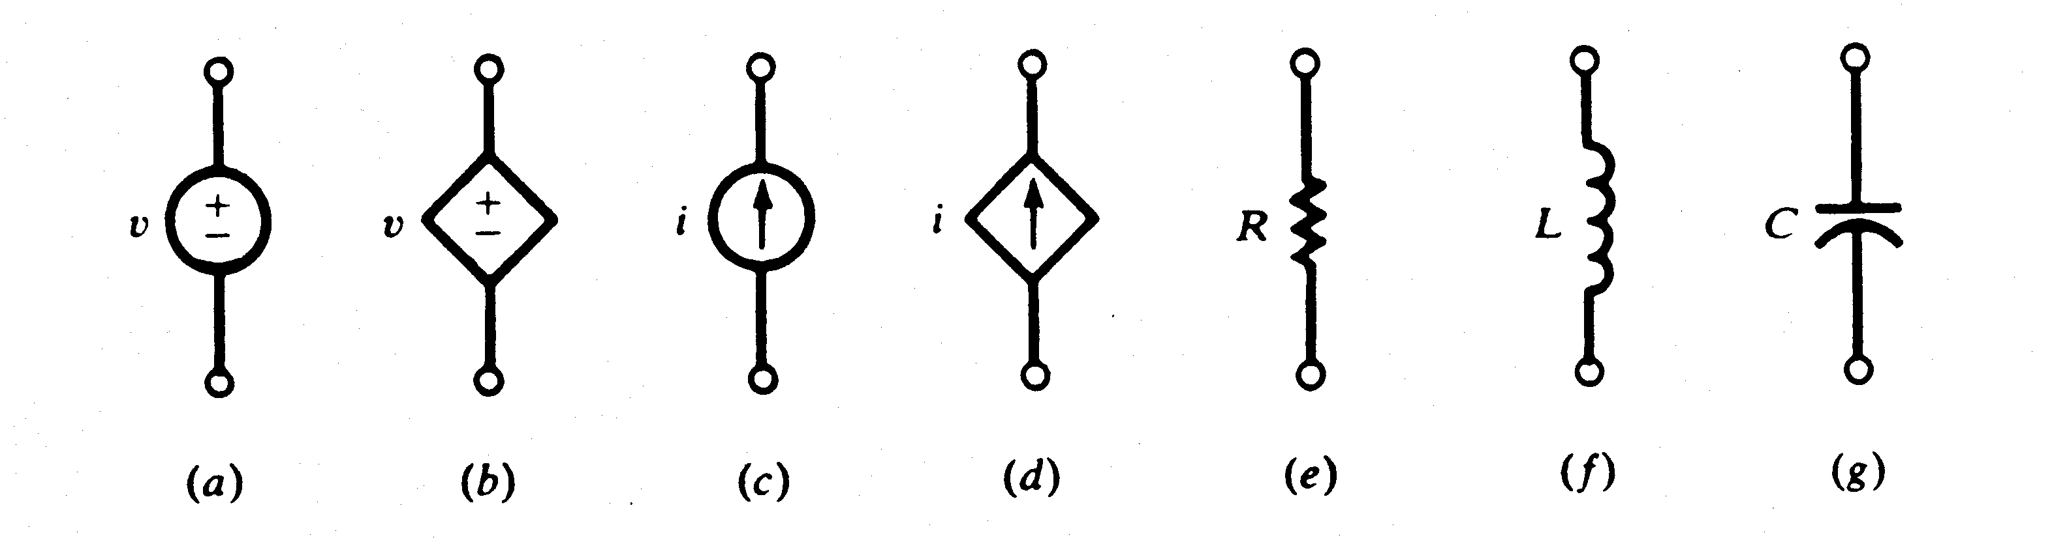
1.7 Circuit Elements
Active Elements
Passive Elements
A dependent source is an active element in which the source quantity is controlled by another voltage or current.
They have four different types: VCVS, CCVS, VCCS, CCCS. Keep in minds the signs of dependent sources.
Independent
sources
Dependant
sources

Slide 27
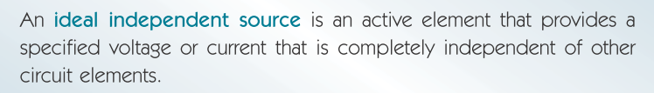
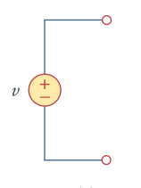
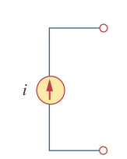
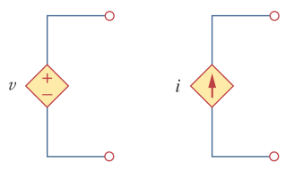
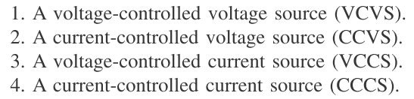
1.7 Circuit Elements

Slide 28
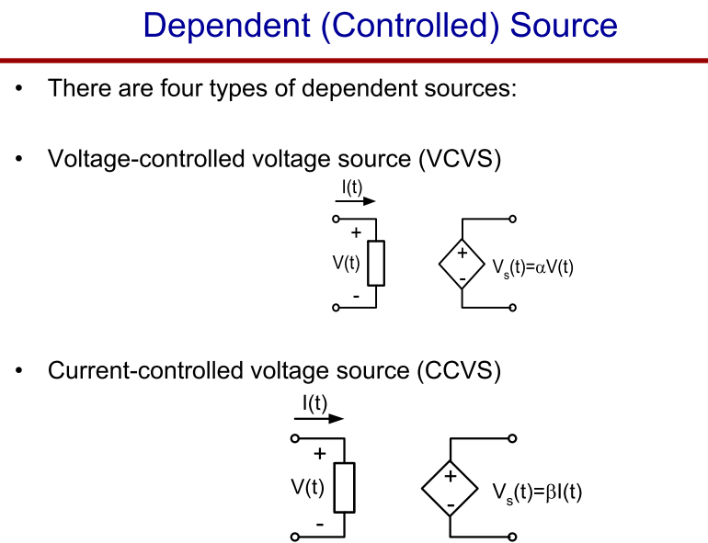
1.7 Circuit Elements
Input V
Output V
Input I
Output V

Slide 29
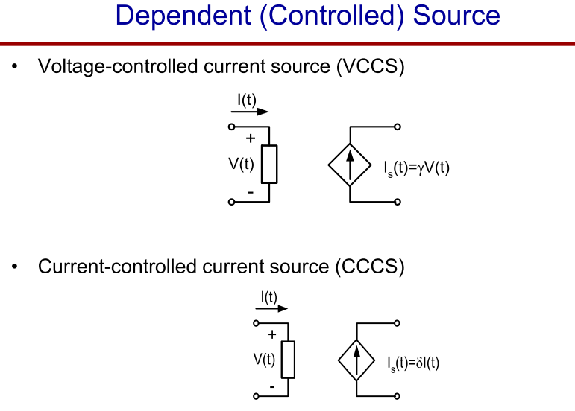
1.7 Circuit Elements
Input V
Output I
Input I
Output I

Slide 30
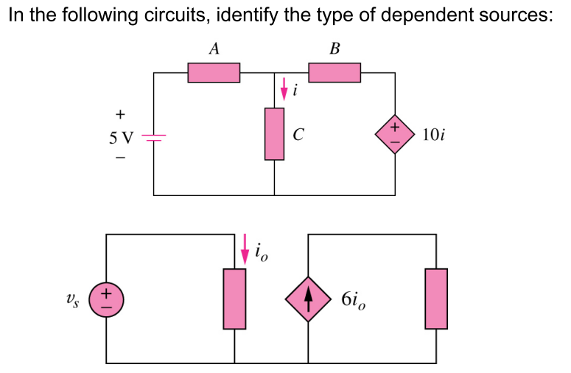
1.7 Circuit Elements
Exercise

Slide 31
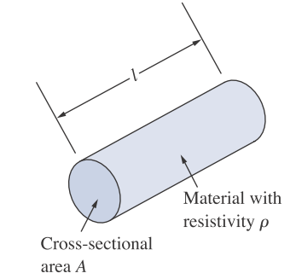
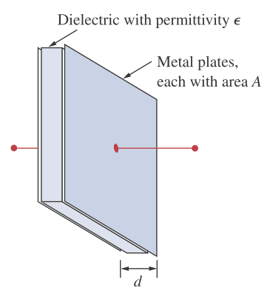
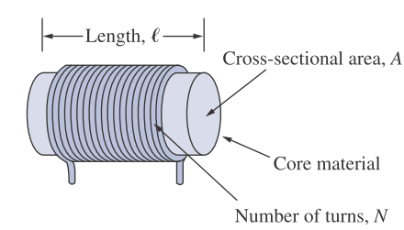
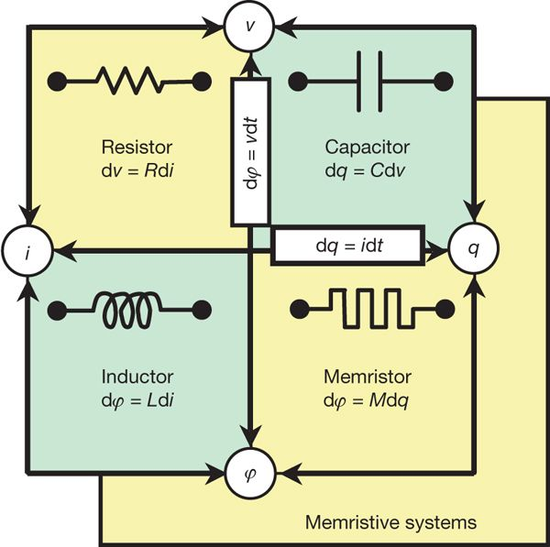
1.7 Circuit Elements
R
L
C
Resistor
Inductor
Capacitor
M
Memristor
Gao et al., A High‐Performance Memristor Device and Its Filter Circuit Application. Rapid Research Letters 14(12). 2020.
Fu et al., Bioinspired bio-voltage memristors. Nature Communications 1861 (2020).

Slide 32
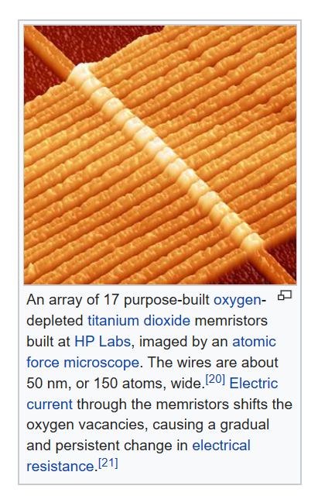
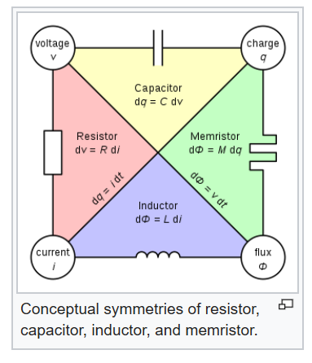
Memristor

Slide 33
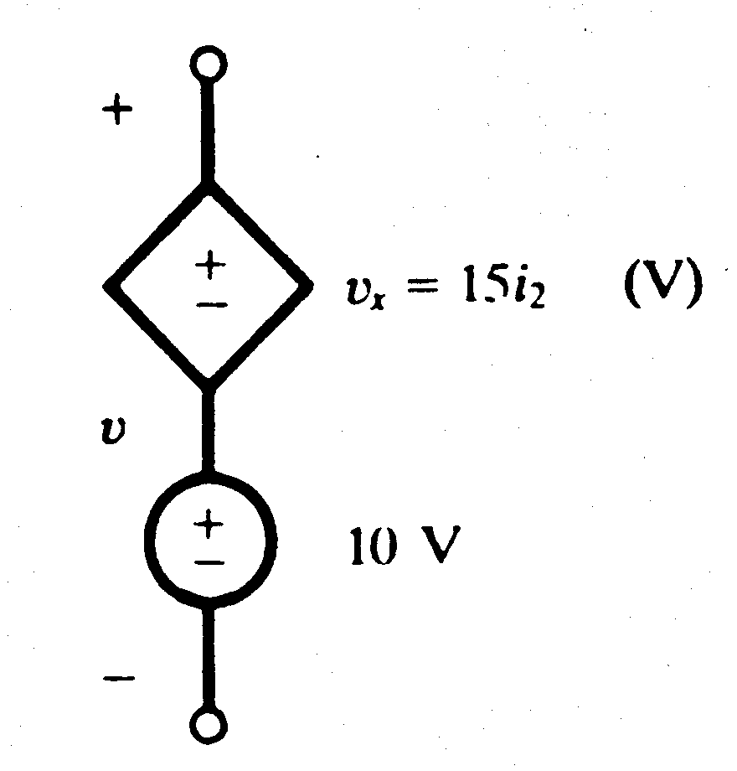
1.7 Circuit Elements
Example 4
Obtain the voltage v in the branch shown in Figure 2.1.1P for i₂ = 1A.
Figure 2.1.1P

Slide 34
1.7 Circuit Elements
Solution
Voltage v is the sum of the current-independent 10-V source and the current-dependent voltage source v_{x}.
Note that the factor 15 multiplying the control current carries the units Ω.
Therefore, v = 10 + v_{x} = 10 + 15(1) = 25 V

